Slide 1
Ch.4 Evaluation of Uncertainty in
Time-Domain Spectroscopy
Lee Jong Geon

Slide 2
Contents
Method of Uncertainty Evaluation
Sources of Uncertainty in Terahertz Time-Domain Spectroscopy
Practical Implementation

Slide 3
Method of
Uncertainty Evaluation

Slide 4
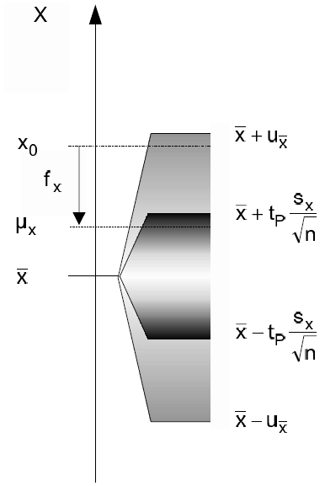
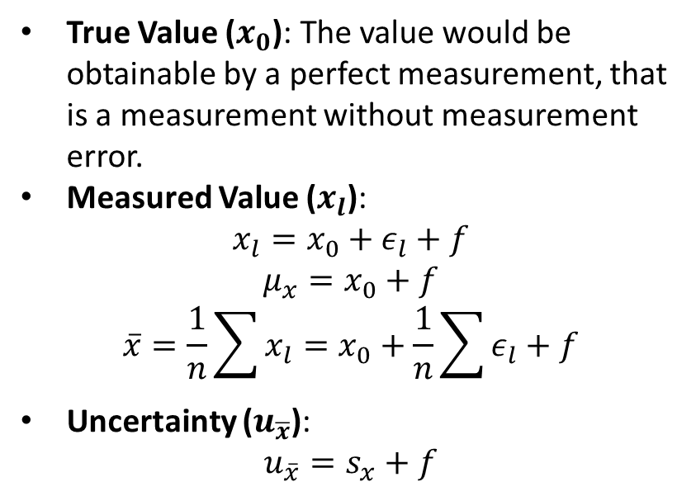
1.1 General Definitions
Type A uncertainty: uncertainty by a statistical analysis of quantity values obtained by measurements under repeatability conditions
Type B uncertainty: uncertainty by means other than a statistical analysis of quantity values obtained by measurement
True Value ($x_{0}$): The value would be obtainable by a perfect measurement, that is a measurement without measurement error.
Measured Value ($x_{l}$):
$$x_{l}=x_{0}+ε_{l}+f$$
$$μ_{x}=x_{0}+f$$
$$\overline{x}=\frac{1}{n}\sum{x_{l}}=x_{0}+\frac{1}{n}\sum{ε_{l}}+f$$
Uncertainty ($u_{\overline{x}}$):
$$u_{\overline{x}}=s_{x}+f$$
International Vocabulary of Basic and General Terms in Metrology (VIM), ISO, 2004.
Grabe, M., Measurement Uncertainties in Science and Technology, New York: Springer, 2005.

Slide 5
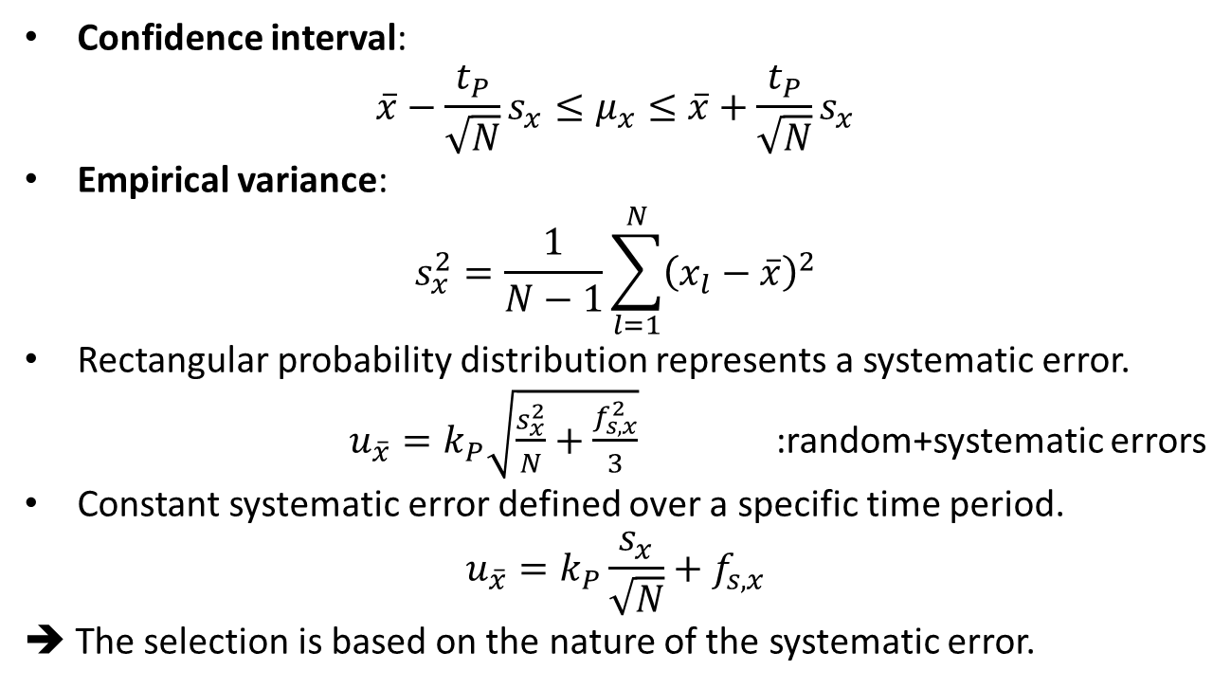
1.2 Evaluation of Random and Systematic Errors
Confidence interval:
$$\overline{x}−\frac{t_{P}}{\sqrt{N}}s_{x}≤μ_{x}≤\overline{x}+\frac{t_{P}}{\sqrt{N}}s_{x}$$
Empirical variance:
$$s_{x}^{2}=\frac{1}{N−1}\sum_{l=1}^{N}{{\left(x_{l}−\overline{x}\right)}^{2}}$$
Rectangular probability distribution represents a systematic error.
$u_{\overline{x}}=k_{P}\sqrt{\frac{s_{x}^{2}}{N}+\frac{f_{s,x}^{2}}{3}}$ :random+systematic errors
Constant systematic error defined over a specific time period.
$$u_{\overline{x}}=k_{P}\frac{s_{x}}{\sqrt{N}}+f_{s,x}$$
➔ The selection is based on the nature of the systematic error.
International Vocabulary of Basic and General Terms in Metrology (VIM), ISO, 2004.
Grabe, M., Measurement Uncertainties in Science and Technology, New York: Springer, 2005.

Slide 6
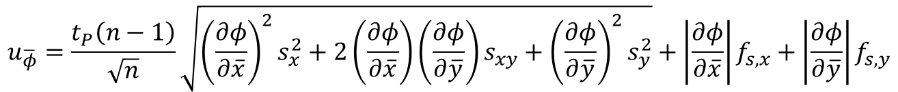
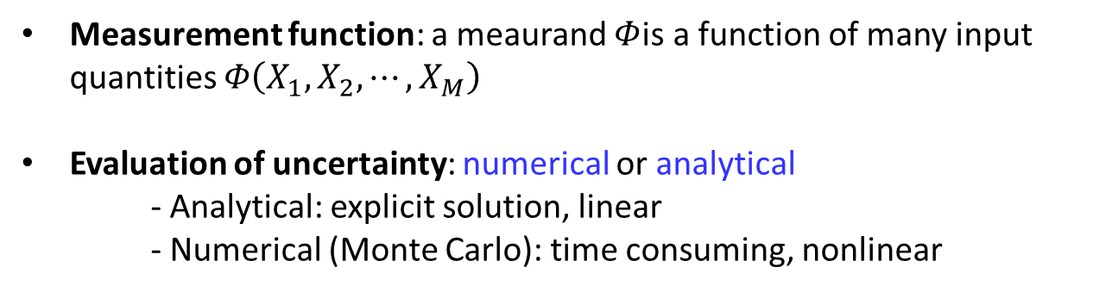
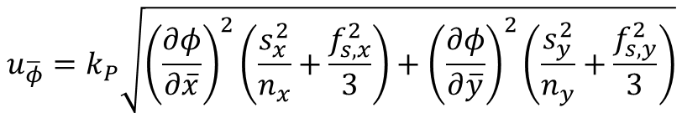

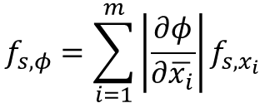
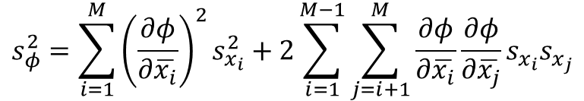
1.3 Propagation and Combination of Measurement Uncertainty
Measurement function: a meaurand $Φ$is a function of many input quantities $Φ\left(X_{1}, X_{2}, ⋯, X_{M}\right)$
Evaluation of uncertainty: numerical or analytical
- Analytical: explicit solution, linear
- Numerical (Monte Carlo): time consuming, nonlinear
Analytical evaluation
$$s_{φ}^{2}=\sum_{i=1}^{M}{{\left(\frac{∂φ}{∂\overline{x_{i}}}\right)}^{2}s_{x_{i}}^{2}}+2\sum_{i=1}^{M−1}{\sum_{j=i+1}^{M}{\frac{∂φ}{∂\overline{x_{i}}}\frac{∂φ}{∂\overline{x_{j}}}s_{x_{i}}s_{x_{j}}}}$$
$$f_{s,φ}=\sum_{i=1}^{m}{\left|\frac{∂φ}{∂\overline{x_{i}}}\right|f_{s,x_{i}}}$$
$$;−f_{s,x_{i}}≤f_{x_{i}}≤f_{s,x_{i}}$$
$$u_{\overline{φ}}=k_{P}\sqrt{{\left(\frac{∂φ}{∂\overline{x}}\right)}^{2}\left(\frac{s_{x}^{2}}{n_{x}}+\frac{f_{s,x}^{2}}{3}\right)+{\left(\frac{∂φ}{∂\overline{y}}\right)}^{2}\left(\frac{s_{y}^{2}}{n_{y}}+\frac{f_{s,y}^{2}}{3}\right)}$$
$$u_{\overline{φ}}=\frac{t_{P}\left(n−1\right)}{\sqrt{n}}\sqrt{{\left(\frac{∂φ}{∂\overline{x}}\right)}^{2}s_{x}^{2}+2\left(\frac{∂φ}{∂\overline{x}}\right)\left(\frac{∂φ}{∂\overline{y}}\right)s_{xy}+{\left(\frac{∂φ}{∂\overline{y}}\right)}^{2}s_{y}^{2}}+\left|\frac{∂φ}{∂\overline{x}}\right|f_{s,x}+\left|\frac{∂φ}{∂\overline{y}}\right|f_{s,y}$$
Grabe, M., “Estimation of Measurement Uncertainties-An Alternative to the ISO Guide,” Metrologia, Vol. 38, 2001.

Slide 7
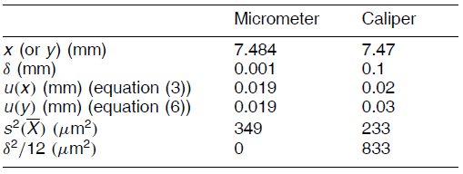



1.4 Measurement with Resolution Limit
A resolution limit in a measuring device can give rise to a systematic error.
measurand$=x_{l}+∆$
$$; \left|∆\right|≤δ/2$$
Variance $=s_{x}^{2}+\frac{δ^{2}}{12}$
Lira, I. H., and W. Wöger, “The Evaluation od Standard Uncertainty in the Presence of Limited Resolution of Indicating Devices,” Measurement Science and Technology, Vol. 8, 1997.

Slide 8
Sources of Unccertainty in
Terahertz TDS

Slide 9
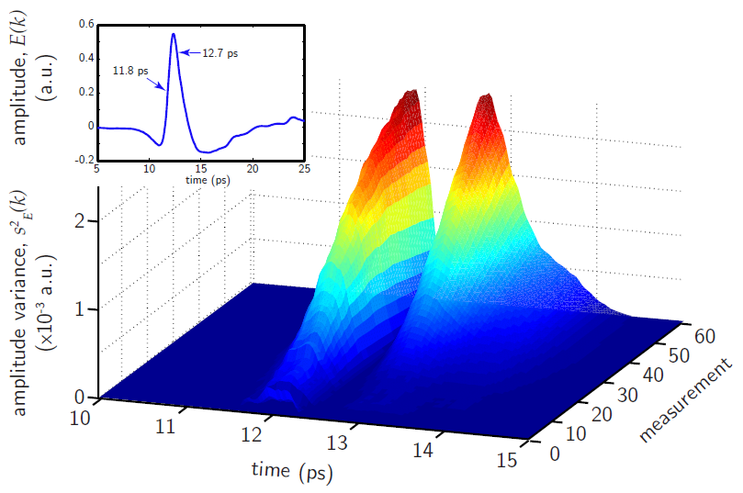
2.1 Random and Systematic Errors in Amplitude
A random error occurs in a relatively short time scale, in contrast to a systematic error that can be observed only when the measurement time span is long enough
Withayachumnankul, W., B. M. Fischer, H. Lin, and D. Abbott, “Uncertainty in terahertz time-domain spectroscopy measurement,” Journal of the Optical Society of America, Vol. 25, No. 6, 2008.

Slide 10
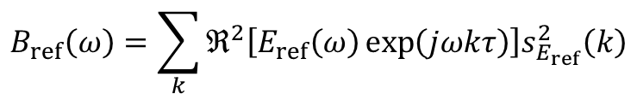
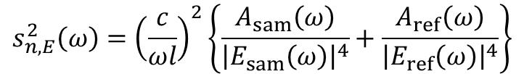
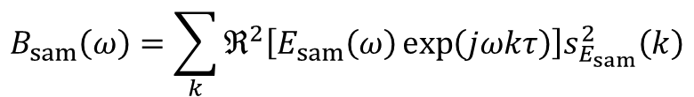
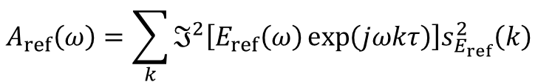
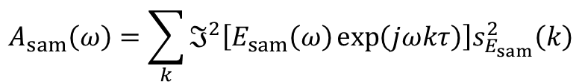
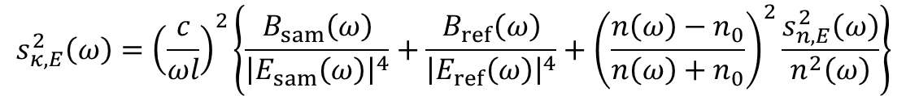
2.1 Random and Systematic Errors in Amplitude
$$s_{n,E}^{2}\left(ω\right)={\left(\frac{c}{ωl}\right)}^{2}\left\{\frac{A_{sam}\left(ω\right)}{{\left|E_{sam}\left(ω\right)\right|}^{4}}+\frac{A_{ref}\left(ω\right)}{{\left|E_{ref}\left(ω\right)\right|}^{4}}\right\}$$
$$s_{κ,E}^{2}\left(ω\right)={\left(\frac{c}{ωl}\right)}^{2}\left\{\frac{B_{sam}\left(ω\right)}{{\left|E_{sam}\left(ω\right)\right|}^{4}}+\frac{B_{ref}\left(ω\right)}{{\left|E_{ref}\left(ω\right)\right|}^{4}}+{\left(\frac{n\left(ω\right)−n_{0}}{n\left(ω\right)+n_{0}}\right)}^{2}\frac{s_{n,E}^{2}\left(ω\right)}{n^{2}\left(ω\right)}\right\}$$
Where,
$$A_{sam}\left(ω\right)=\sum_{k}{ℑ^{2}\left[E_{sam}\left(ω\right)\exp\left(jωkτ\right)\right]s_{E_{sam}}^{2}\left(k\right)}$$
$$A_{ref}\left(ω\right)=\sum_{k}{ℑ^{2}\left[E_{ref}\left(ω\right)\exp\left(jωkτ\right)\right]s_{E_{ref}}^{2}\left(k\right)}$$
Increasing thickness
➔ decrease the variance
$$B_{sam}\left(ω\right)=\sum_{k}{ℜ^{2}\left[E_{sam}\left(ω\right)\exp\left(jωkτ\right)\right]s_{E_{sam}}^{2}\left(k\right)}$$
$$B_{ref}\left(ω\right)=\sum_{k}{ℜ^{2}\left[E_{ref}\left(ω\right)\exp\left(jωkτ\right)\right]s_{E_{ref}}^{2}\left(k\right)}$$
Withayachumnankul, W., B. M. Fischer, H. Lin, and D. Abbott, “Uncertainty in terahertz time-domain spectroscopy measurement,” Journal of the Optical Society of America, Vol. 25, No. 6, 2008.

Slide 11
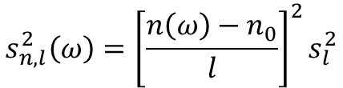
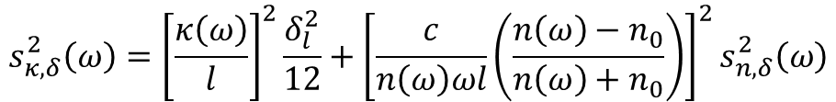
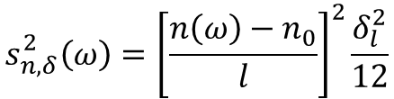
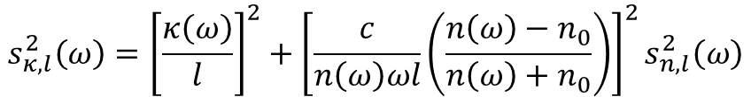
2.2 Random and Systematic Errors in Sample Thickness
Random error in thickness measurement
The mechanical pressure
Bio-sample can shrink due to dehydration or cryogenically frozen
Random Error in Sample Thickness
$$s_{n,l}^{2}\left(ω\right)={\left[\frac{n\left(ω\right)−n_{0}}{l}\right]}^{2}s_{l}^{2}$$
$$s_{κ,l}^{2}\left(ω\right)={\left[\frac{κ\left(ω\right)}{l}\right]}^{2}+{\left[\frac{c}{n\left(ω\right)ωl}\left(\frac{n\left(ω\right)−n_{0}}{n\left(ω\right)+n_{0}}\right)\right]}^{2}s_{n,l}^{2}\left(ω\right)$$
Systematic Error in Sample Thickness (Resolution Limit)
$$s_{n,δ}^{2}\left(ω\right)={\left[\frac{n\left(ω\right)−n_{0}}{l}\right]}^{2}\frac{δ_{l}^{2}}{12}$$
$$s_{κ,δ}^{2}\left(ω\right)={\left[\frac{κ\left(ω\right)}{l}\right]}^{2}\frac{δ_{l}^{2}}{12}+{\left[\frac{c}{n\left(ω\right)ωl}\left(\frac{n\left(ω\right)−n_{0}}{n\left(ω\right)+n_{0}}\right)\right]}^{2}s_{n,δ}^{2}\left(ω\right)$$
Increasing thickness ➔ decrease the variance
However a thicker sample also results in a weaker sample signal.

Slide 12
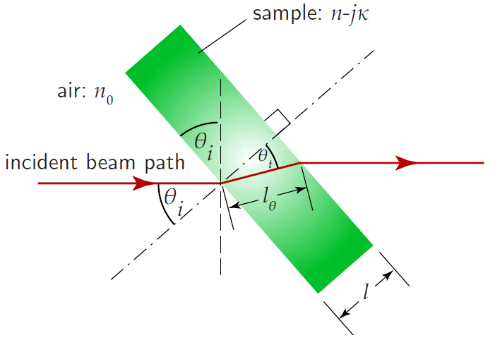


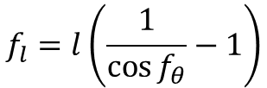
2.3 Random and Systematic Errors in Sample Alignment
If the sample is moved in among several measurements, the error is random. However, if the sample is fixed throughout measurements, the error from the sample alignment is systematic.
$$f_{l}=l\left(\frac{1}{\cos{f_{θ}}}−1\right)$$
$$f_{n,θ}\left(ω\right)=\frac{n\left(ω\right)−n_{0}}{l}f_{l}$$
$$f_{κ,θ}\left(ω\right)=\frac{κ\left(ω\right)}{l}f_{l}+\frac{c}{n\left(ω\right)ωl}\frac{n\left(ω\right)−n_{0}}{n\left(ω\right)+n_{0}}f_{n,θ}\left(ω\right)$$
The deviation in the refractive index due to the sample alignment is independent of the sample thickness

Slide 13
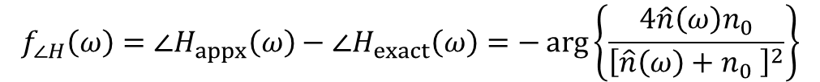
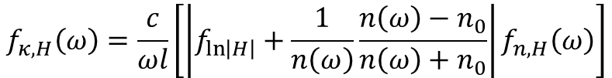

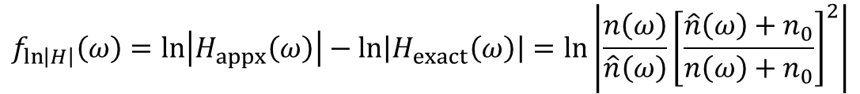
2.4 Systematic Error in the Approximated Transfer Function
The optical constants can be based on an approximated transfer function.
$$f_{∠H}\left(ω\right)=∠H_{appx}\left(ω\right)−∠H_{exact}\left(ω\right)=−\arg\left\{\frac{4\hat{n}\left(ω\right)n_{0}}{{\left[\hat{n}\left(ω\right)+n_{0} \right]}^{2}}\right\}$$
$$f_{\ln\left|H\right|}\left(ω\right)=\ln\left|H_{appx}\left(ω\right)\right|−\ln\left|H_{exact}\left(ω\right)\right|=\ln\left|\frac{n\left(ω\right)}{\hat{n}\left(ω\right)}{\left[\frac{\hat{n}\left(ω\right)+n_{0}}{n\left(ω\right)+n_{0}}\right]}^{2}\right|$$
$$f_{n,H}\left(ω\right)=\frac{c}{ωl}\left|f_{∠H}\left(ω\right)\right|$$
$$f_{κ,H}\left(ω\right)=\frac{c}{ωl}\left[\left|f_{\ln\left|H\right|}+\frac{1}{n\left(ω\right)}\frac{n\left(ω\right)−n_{0}}{n\left(ω\right)+n_{0}}\right|f_{n,H}\left(ω\right)\right]$$
However, a precise approach involves a complicated iterative calculation, and most researchers trade off this complexity with a small error from the approximation

Slide 14




2.5 Systematic Error in Physical Constants
The refractive index of air is slightly larger than unity and is dependent on the temperature and pressure.
$$n_{0,exact}=1+\frac{86.26\left(5748+T\right)p}{T^{2}}{10}^{−6}$$
0.89THz, 298.15K, 23.76mmHg ➔ index offset=1.4$×{10}^{−4}$
$$f_{n,n_{0}}\left(ω\right)=\left|f_{n_{0}}\right|$$
$$;f_{n_{0}}=n_{0}−n_{0,exact}$$
$$f_{κ,n_{0}}\left(ω\right)=\frac{c}{ωl}\frac{n\left(ω\right)−n_{0}}{n\left(ω\right)n_{0}}f_{n_{0}}$$

Slide 15
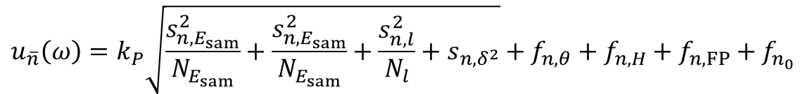
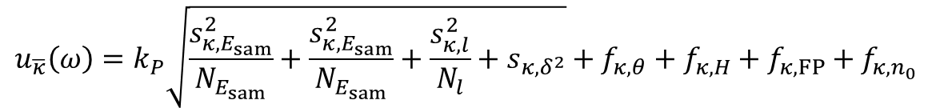
2.6 Uncertainty in Optical constants: A Combination of Variance
Many sources of error contribute to the variance of the measured optical constants. The combination could be either arithmetic or geometric, dependent on the type of source.
$$u_{\overline{n}}\left(ω\right)=k_{P}\sqrt{\frac{s_{n,E_{sam}}^{2}}{N_{E_{sam}}}+\frac{s_{n,E_{sam}}^{2}}{N_{E_{sam}}}+\frac{s_{n,l}^{2}}{N_{l}}+s_{n,δ^{2}}}+f_{n,θ}+f_{n,H}+f_{n,FP}+f_{n_{0} }$$
$$u_{\overline{κ}}\left(ω\right)=k_{P}\sqrt{\frac{s_{κ,E_{sam}}^{2}}{N_{E_{sam}}}+\frac{s_{κ,E_{sam}}^{2}}{N_{E_{sam}}}+\frac{s_{κ,l}^{2}}{N_{l}}+s_{κ,δ^{2}}}+f_{κ,θ}+f_{κ,H}+f_{κ,FP}+f_{κ,n_{0} }$$

Slide 16
Practical Implementation

Slide 17
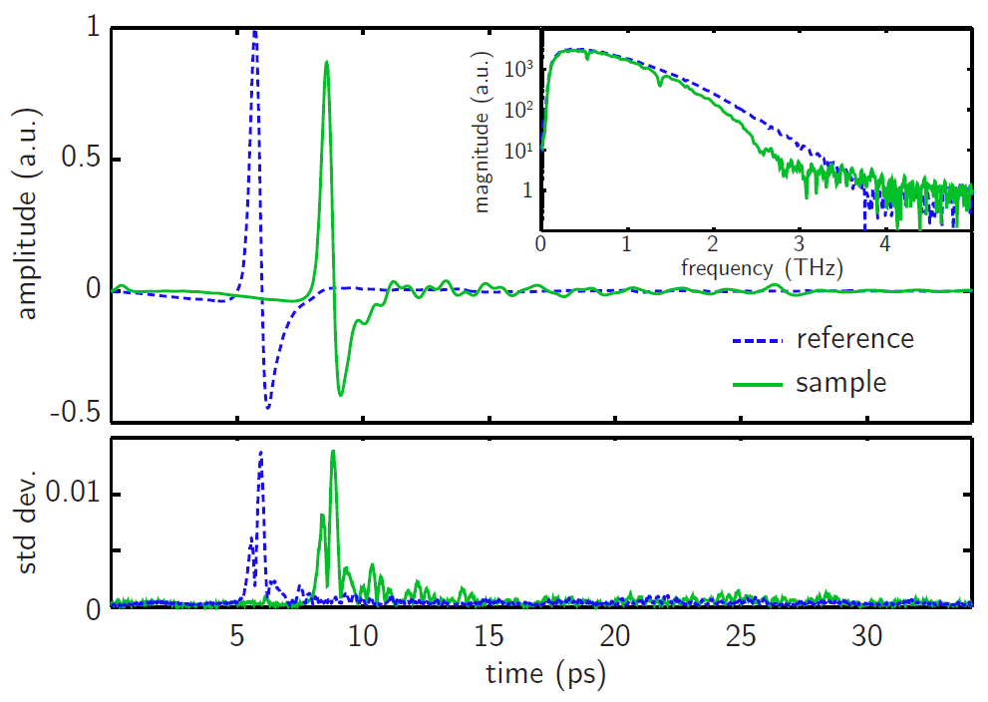
3. Practical Implemantation
Many sources of error contribute to the variance of the measured optical constants. The combination could be either arithmetic or geometric, dependent on the type of source.

Slide 18
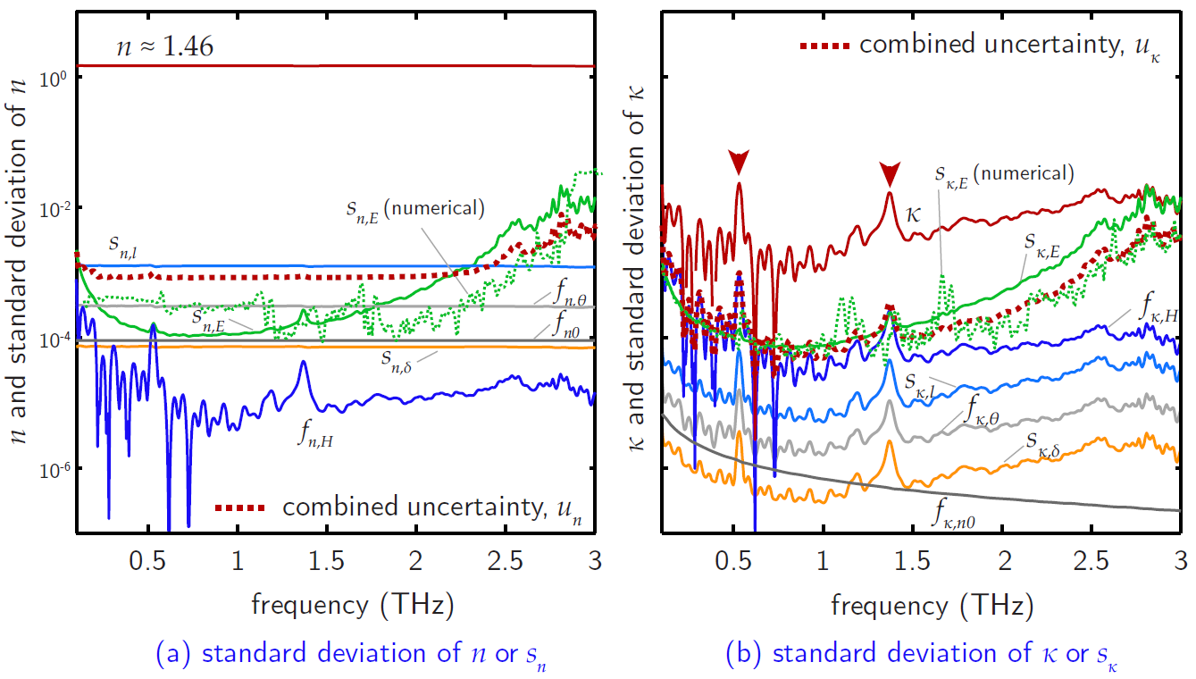
3. Practical Implemantation
Many sources of error contribute to the variance of the measured optical constants. The combination could be either arithmetic or geometric, dependent on the type of source.

Slide 19
References
Grabe, M., Measurement Uncertainties in Science and Technology, New York: Springer, 2005.
Grabe, M., “Estimation of Measurement Uncertainties-An Alternative to the ISO Guide,” Metrologia, Vol. 38, 2001, pp. 97-106.
International Vocabulary of Basic and General Terms in Metrology (VIM), ISO, 2004.
Lira, I. H., and W. Wöger, “The Evaluation od Standard Uncertainty in the Presence of Limited Resolution of Indicating Devices,” Measurement Science and Technology, Vol. 8, 1997, pp. 441-443.
Withayachumnankul, W., B. M. Fischer, H. Lin, and D. Abbott, “Uncertainty in terahertz time-domain spectroscopy measurement,” Journal of the Optical Society of America, Vol. 25, No. 6, 2008, pp. 0159-1072.

